Slide 1
Marketing Lecture # 18 Muhammad asad Instructor department of computer science

Slide 2
Key Learning Point :-
- Discussion about corporate level strategies

Slide 3
BCG MATRIX
The first portfolio matrix --- The BCG matrix was developed by the Boston Consulting Group (1970) and introduced the idea that an organization’s various businesses could be evaluated and planned using a 2 by 2 matrix --- To identify which ones offered high potential and which were a drain on organizational resources.
BCG PURPOSE: Product portfolio selection & Investment strategy

Slide 4
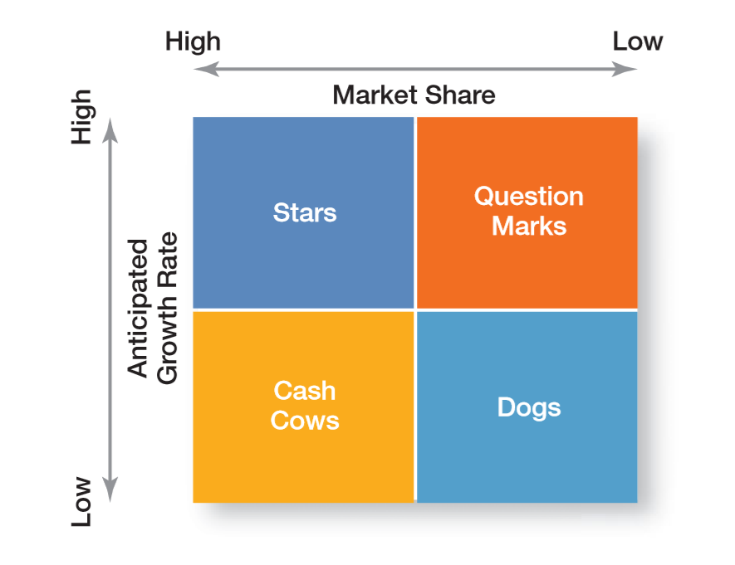

Slide 5
COMPONENT OF BCG MATRIX
MARKET SHARE represents the percentage of an industry or a market's total sales --- That is earned by a particular company over a specified time period --- Market share is calculated by taking the company's sales over the period and dividing it by the total sales of the industry over the same period.
MARKET GROWTH is the increase or decrease in the size of a market for a product or service over time --- It is typically measured as the percentage change in total sales in an industry or product category --- In simple words, An increase in the demand for a particular product or service over time.

Slide 6
STARS High Growth and High Market Share --- The stars exist in high growth markets and generate the most cash --- It is advised to invest in Stars --- If these products sustain their success until market growth rate declines --- The stars may eventually become cash cows.
CASH COWS Low Growth and High Market Share --- These products generate a more significant amount of cash than consumed. It is advised to “milk” the gains and invest in cash cows to maintain their current level of productivity.

Slide 7
QUESTION MARKS OR PROBLEM CHILD Products in High Growth Markets with Low Market Share --- These products are a question mark in the entire portfolio --- They consume a lot of cash while very less amount is brought in return --- May end up losing money. The company can either discontinue the product or invest to make improvements.
DOGS Low Growth and Market Share --- These products have breakeven inflows and outflows of cash. It is advised to discontinue investments in dogs --- That discontinued investment cash use in profitable products.

Slide 8
DEVELOPING STRATEGIES
The four different kinds of decision-based on the BCG Matrix…
BUILD THE PRODUCT – Develop the product by investing to increase its market share. Recommended for Question Marks to turn into Cash Cows.
HOLD THE PRODUCT – Leaving a business unit or product for some time if you are unable to invest more into it. Usually applied in Star Products.

Slide 9
DIVEST – Release the cash stuck where there’s no profit or discontinue the product. Best for Dogs.
HARVEST – Reducing the cash investments in a product to generate maximum cash inflow from the product. This strategy is best applied to Cash Cows which improves the overall profitability of the business.

Slide 10

ANY QUESTION
You can contact me at: asadali@uosahiwal.edu.pk
Your query will be answered within one working day.

